Slide 1
Efficient parameterized string matching
Kimmo Fredriksson and Maxim Mozgovoy
Information Processing Letters, Vol. 100, pp. 91-96, 2006
Speaker: Chun-Jen Chen
Date: Sep 19, 2007

Slide 2
Abstrct
In parameterized string matching the pattern P matches a substring t of the text T if there exist a bijective mapping from the symbols of P to the symbols of t . We give simple and practical algorithms for finding all such pattern occurrences in sublinear time on average. The algorithms work for a single and multiple patterns.

Slide 3
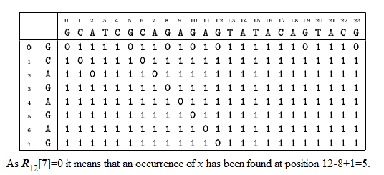
Shift-Or algorithm

Slide 4
The Table B
 | B[A] | B[C] | B[G] | B[T]
G | 1 | 1 | 0 | 1
C | 1 | 0 | 1 | 1
A | 0 | 1 | 1 | 1
G | 1 | 1 | 0 | 1
A | 0 | 1 | 1 | 1
G | 1 | 1 | 0 | 1
A | 0 | 1 | 1 | 1
G | 1 | 1 | 0 | 1

Slide 5
Parameterized string match
  The symbols from Σ must match exactly
  The symbols from Λ can be renamed
P=AAZYZABXYZAX
T=AAXYXABZYXAZ
X → Z Y→Y Z→X
Σ= { A, B }
Λ= { X, Y, Z }

Slide 6
Preliminaries
P =AAZYZABXYZAX
prev(P)=AA002AB055A4
T =AAXYXABZYXAZ
prev(T)=AA002AB055A4
The problem is reduced to exact string matching!!
→ prev(P)=prev(T)

Slide 7

Lemma 1.
X
↓
(i – j)

Slide 8
S =AAZYZABXYZAX
prev(S)=AA002AB055A4 = S’
j = 6 , m = 7 (S[ j ～ j+m-1] = ABXYZAX)
S’’ = AB055A4 X
S’’ = AB000A4 ○

Slide 9
P- Shift-Or algorithm
T=ZZAZAZAZ T’=01A2A2A2
P=XAXAX P’=0A2A2
 | 0 | 1 | A | 2 | A | 2 | A | 2
0 | 0 | 0 | 1 | 0 | 1 | 0 | 1 | 0
A | 1 | 1 | 0 | 1 | 0 | 1 | 0 | 1
2 | 1 | 1 | 1 | 0 | 1 | 0 | 1 | 0
A | 1 | 1 | 1 | 1 | 0 | 1 | 0 | 1
2 | 1 | 1 | 1 | 1 | 1 | 0 | 1 | 0
 | B[A] | B[0] | B[2]
0 | 1 | 0 | 1
A | 0 | 1 | 1
2 | 1 | 1 | 0
A | 0 | 1 | 1
2 | 1 | 1 | 0

